Slide 1
Automatic Causal Discovery
Richard Scheines
Peter Spirtes, Clark Glymour
Dept. of Philosophy & CALD
Carnegie Mellon

Slide 2
Outline
Motivation
Representation
Discovery
Using Regression for Causal Discovery

Slide 3
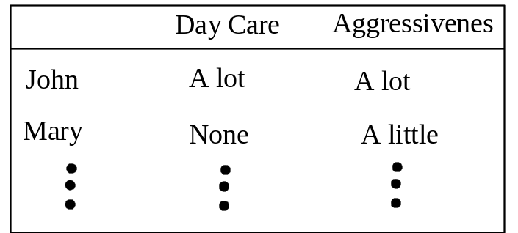
1. Motivation
Non-experimental Evidence
Typical Predictive Questions
Can we predict aggressiveness from Day Care
Can we predict crime rates from abortion rates 20 years ago
Causal Questions:
Does attending Day Care cause Aggression?
Does abortion reduce crime?

Slide 4
Causal Estimation
When and how can we use non-experimental data to tell us about the effect of an intervention?
Manipulated Probability P(Y | X set= x, Z=z)
from
Unmanipulated Probability P(Y | X = x, Z=z)

Slide 5
Conditioning vs. Intervening
P(Y | X = x₁) vs. P(Y | X set= x₁)
⇒ Stained Teeth Slides

Slide 6
2. Representation
Representing causal structure, and connecting it to probability
Modeling Interventions

Slide 7
Causation & Association
X and Y are associated iff
∃x₁ ≠ x₂ P(Y | X = x₁) ≠ P(Y | X = x₂)
X is a cause of Y iff
∃x₁ ≠ x₂ P(Y | X set= x₁) ≠ P(Y | X set= x₂)

Slide 8
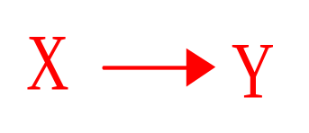
Direct Causation
X is a direct cause of Y relative to S, iff
∃z,x₁ ≠ x₂ P(Y | X set= x_{1 ,} Z set= z)
≠ P(Y | X set= x_{2 ,} Z set= z)
where Z = S - {X,Y}

Slide 9
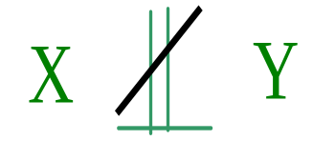
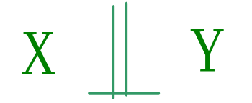
Association
X and Y are associated iff
∃x₁ ≠ x₂ P(Y | X = x₁) ≠ P(Y | X = x₂)
X and Y are independent iff
X and Y are not associated

Slide 10
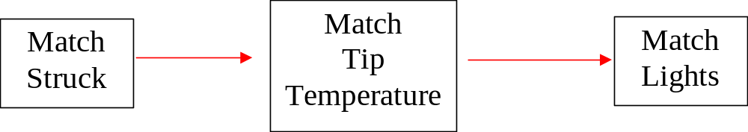
Causal Graphs
Causal Graph G = {V,E}
Each edge X → Y represents a direct causal claim:
X is a direct cause of Y relative to V
Notes:
1. don’t define causality - but will introduce axioms to connect probability to causality
2. many fields proceed without agreement on definition - probability, “force” in mechanics, interpretation of quantum mechanics, etc.
3. a number of different kinds of graphs represent probability distributions and independence - advantage of directed graphs is also represents causal relations
4. will introduce several extensions

Slide 11
Modeling Ideal Interventions
Ideal Interventions (on a variable X):
Completely determine the value or distribution of a variable X
Directly Target only X
  (no “fat hand”)
  E.g., Variables: Confidence, Athletic Performance
  Intervention 1: hypnosis for confidence
  Intervention 2: anti-anxiety drug (also muscle relaxer)

Slide 12
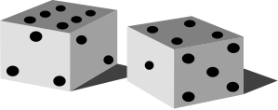
Modeling Ideal Interventions
Interventions on the Effect
Post
Pre-experimental System
Teeth
Stains
Smoking

Slide 13
Modeling Ideal Interventions
Interventions on the Cause
Post
Pre-experimental System
Teeth
Stains
Smoking

Slide 14
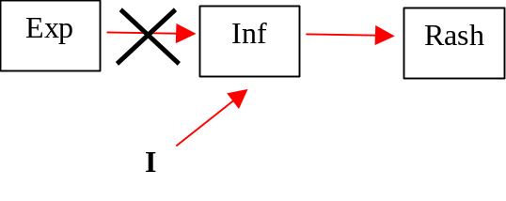

Interventions & Causal Graphs
Model an ideal intervention by adding an “intervention” variable outside the original system
Erase all arrows pointing into the variable intervened upon
Intervene to change Inf
Post-intervention graph?
Pre-intervention graph
Notes:
Fat Hand - intervention - cholesterol drug -- arythmia

Slide 15
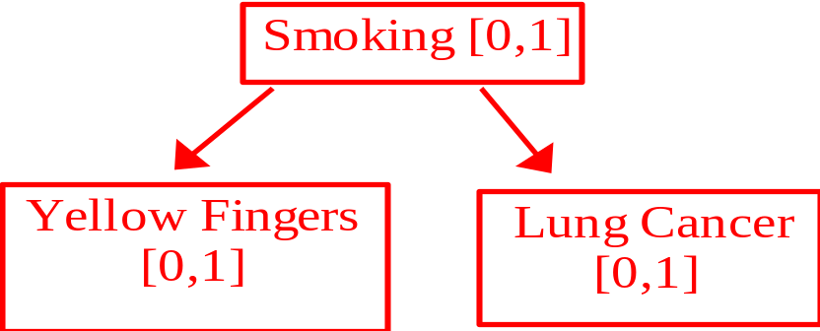
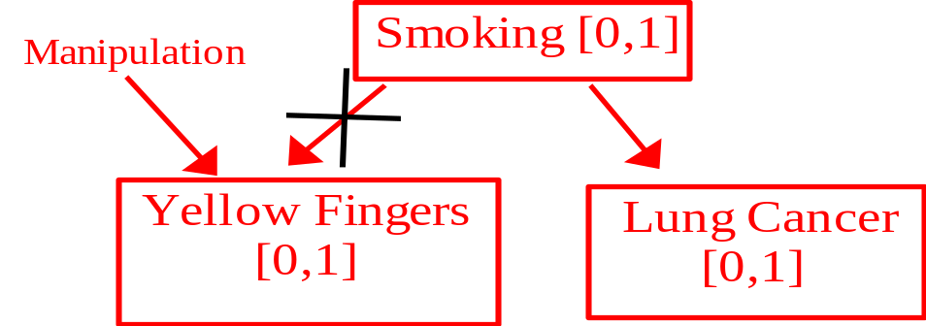
Calculating the Effect of Interventions
P(YF,S,L) = P(S) P(YF|S) P(L|S)
Replace pre-manipulation causes
with manipulation
P(YF,S,L)_{m} = P(S) P(YF|Manip) P(L|S)

Slide 16
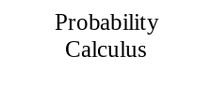
Calculating the Effect of Interventions
P(YF,S,L) = P(S) P(YF|S) P(L|S)
P(L|YF)
P(YF,S,L) = P(S) P(YF|Manip) P(L|S)
P(L| YF set by Manip)

Slide 17
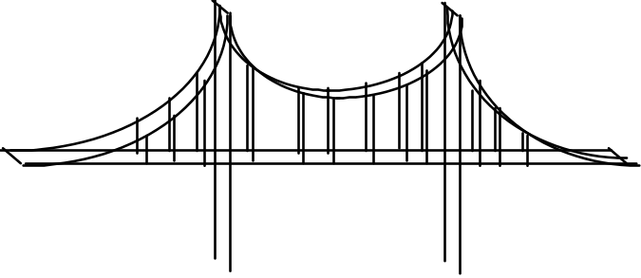
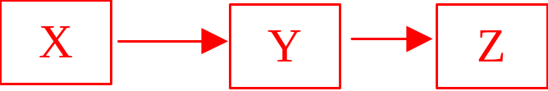
The Markov Condition
Causal
Structure
Statistical Predictions
Markov Condition
Causal Graphs
Independence
X _||_ Z | Y
i.e.,
P(X | Y) = P(X | Y, Z)

Slide 18
Causal Markov Axiom
In a Causal Graph G, each variable V is
independent of its non-effects,
conditional on its direct causes
in every probability distribution that G can parameterize (generate)

Slide 19
Causal Graphs ⇒ Independence
Acyclic causal graphs:
d-separation ⇔ Causal Markov axiom
Cyclic Causal graphs:
Linear structural equation models : d-separation, not Causal Markov
For some discrete variable models: d-separation, not Causal Markov
Non-linear cyclic SEMs : neither

Slide 20
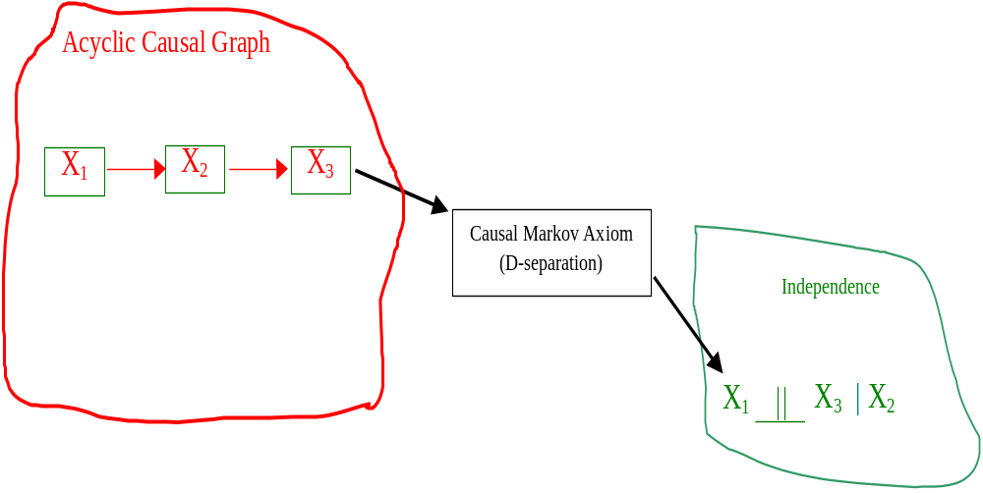
Causal Structure ⇒ Statistical Data

Slide 21
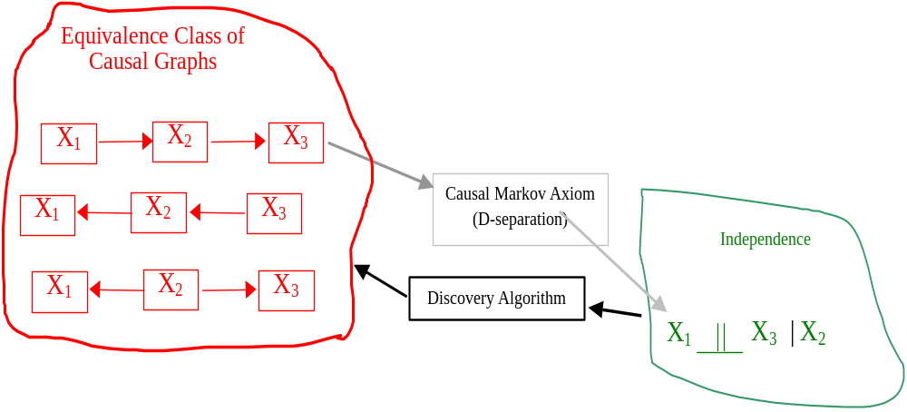
Causal Discovery
Statistical Data ⇒ Causal Structure
Background Knowledge
e.g., X₂ before X₃

Slide 22
Equivalence Classes
D-separation equivalence
D-separation equivalence over a set O
Distributional equivalence
Distributional equivalence over a set O
Two causal models M₁ and M₂ are distributionally equivalent iff for any parameterization θ₁ of M₁, there is a parameterization θ₂ of M₂ such that M₁(θ₁) = M₂(θ₂), and vice versa.

Slide 23
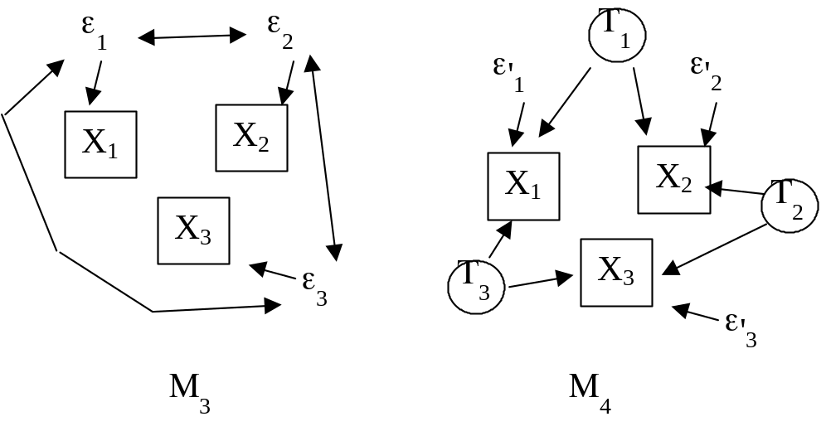
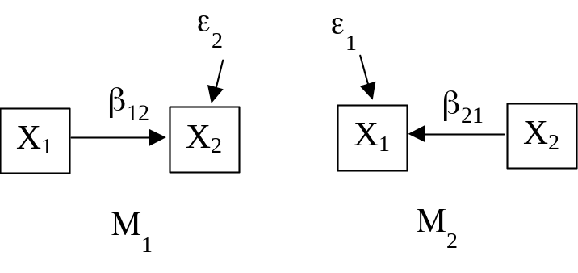
Equivalence Classes
For example, interpreted as SEM models
M₁ and M₂ : d-separation equivalent & distributionally equivalent
M₃ and M₄ : d-separation equivalent & not distributionally equivalent

Slide 24
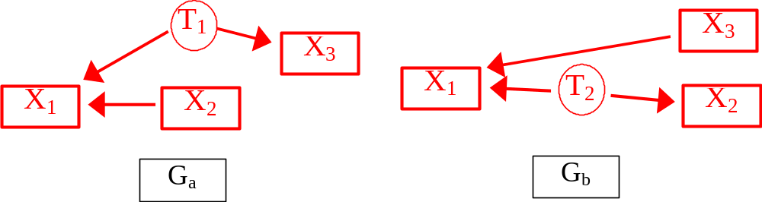
D-separation Equivalence Over a set X
Let X = {X₁,X₂,X₃}, then G_{a} and G_{b}
1) are not d-separation equivalent, but
2) are d-separation equivalent over X

Slide 25
D-separation Equivalence
D-separation Equivalence Theorem (Verma and Pearl, 1988)
Two acyclic graphs over the same set of variables are d-separation equivalent iff they have:
  the same adjacencies
  the same unshielded colliders

Slide 26
Representations of
D-separation Equivalence Classes
We want the representations to:
Characterize the Independence Relations Entailed by the Equivalence Class
Represent causal features that are shared by every member of the equivalence class

Slide 27
Patterns & PAGs
Patterns (Verma and Pearl, 1990): graphical representation of an acyclic d-separation equivalence
- no latent variables.
PAGs: (Richardson 1994) graphical representation of an equivalence class including latent variable models and sample selection bias that are d-separation equivalent over a set of measured variables X

Slide 28
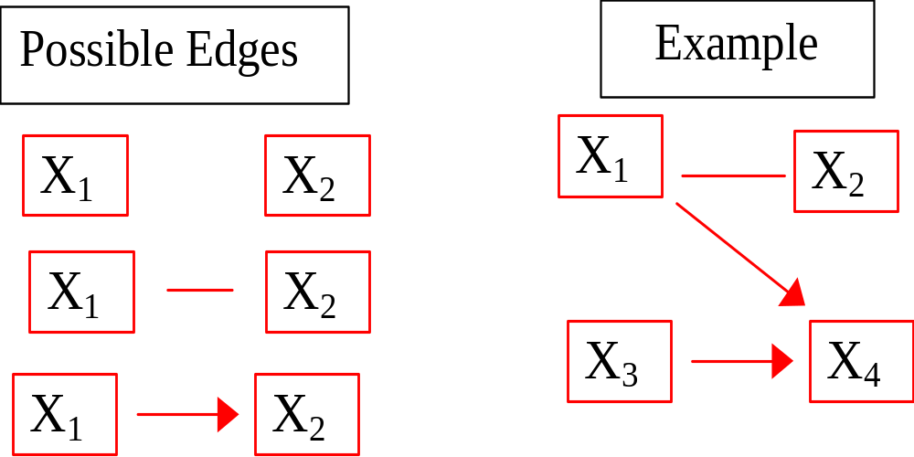
Patterns
Notes:
1. represents set of conditional independence and distribution equivalent graphs
2. same adjacencies
3. undirected edges mean some contain edge one way, some contain other way
4. directed edge means they all go same way
5. Pearl and Verma -complete rules for generating from Meek, Andersson, Perlman, and Madigan, and Chickering
6. instance of chain graph
7. since data can’t distinguish, in absence of background knowledge is right output for search
8. what are they good for?

Slide 29
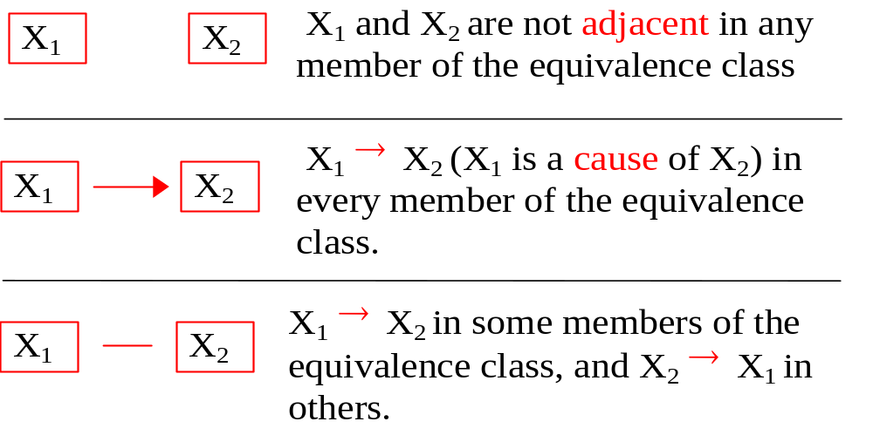
Patterns: What the Edges Mean
Notes:
1. represents set of conditional independence and distribution equivalent graphs
2. same adjacencies
3. undirected edges mean some contain edge one way, some contain other way
4. directed edge means they all go same way
5. Pearl and Verma -complete rules for generating from Meek, Andersson, Perlman, and Madigan, and Chickering
6. instance of chain graph
7. since data can’t distinguish, in absence of background knowledge is right output for search
8. what are they good for?

Slide 30
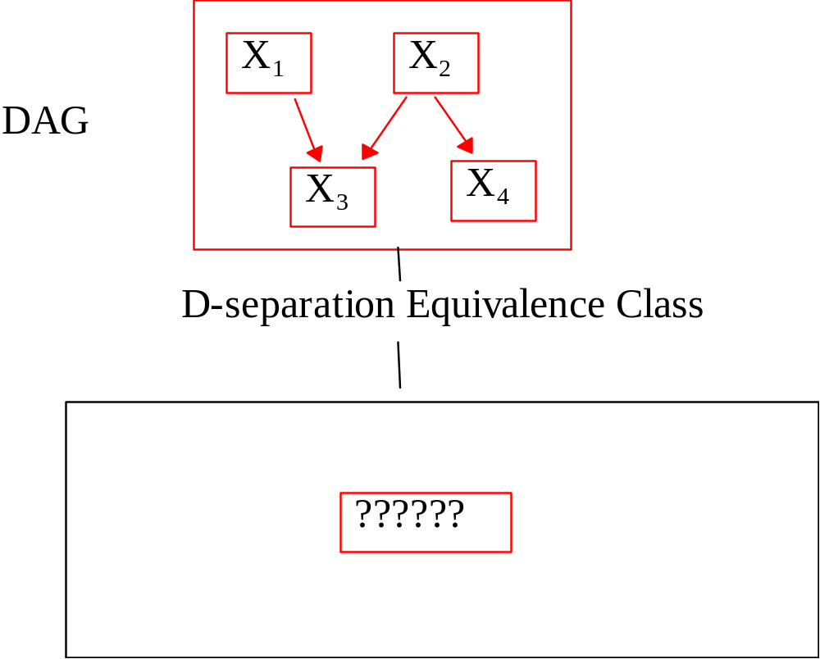
Patterns
Notes:
1. represents set of conditional independence and distribution equivalent graphs
2. same adjacencies
3. undirected edges mean some contain edge one way, some contain other way
4. directed edge means they all go same way
5. Pearl and Verma -complete rules for generating from Meek, Andersson, Perlman, and Madigan, and Chickering
6. instance of chain graph
7. since data can’t distinguish, in absence of background knowledge is right output for search
8. what are they good for?

Slide 31
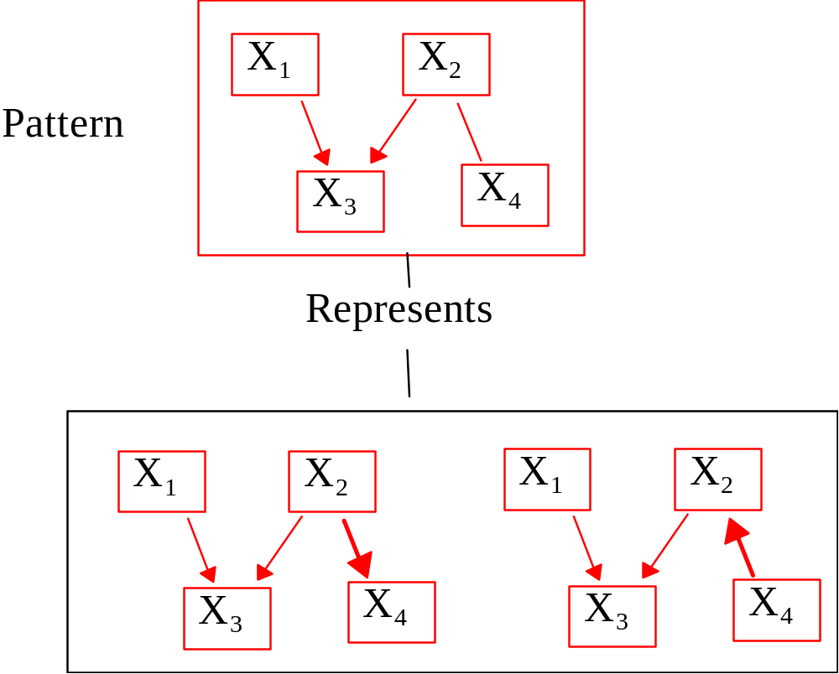
Patterns
Notes:
1. represents set of conditional independence and distribution equivalent graphs
2. same adjacencies
3. undirected edges mean some contain edge one way, some contain other way
4. directed edge means they all go same way
5. Pearl and Verma -complete rules for generating from Meek, Andersson, Perlman, and Madigan, and Chickering
6. instance of chain graph
7. since data can’t distinguish, in absence of background knowledge is right output for search
8. what are they good for?

Slide 32
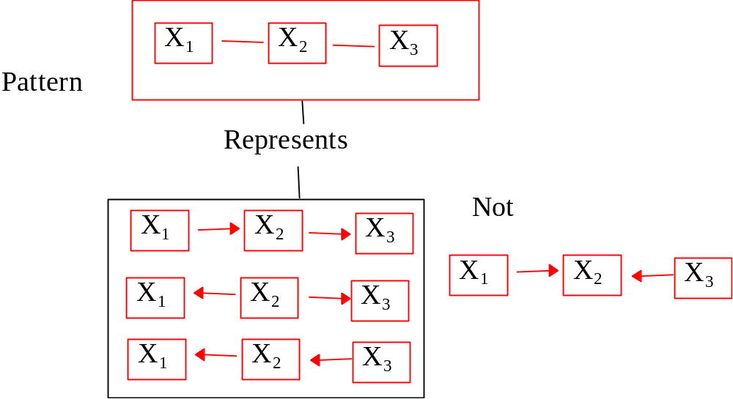
Patterns
Not all boolean combinations of orientations of unoriented pattern adjacencies occur in the equivalence class.
Notes:
1. represents set of conditional independence and distribution equivalent graphs
2. same adjacencies
3. undirected edges mean some contain edge one way, some contain other way
4. directed edge means they all go same way
5. Pearl and Verma -complete rules for generating from Meek, Andersson, Perlman, and Madigan, and Chickering
6. instance of chain graph
7. since data can’t distinguish, in absence of background knowledge is right output for search
8. what are they good for?

Slide 33
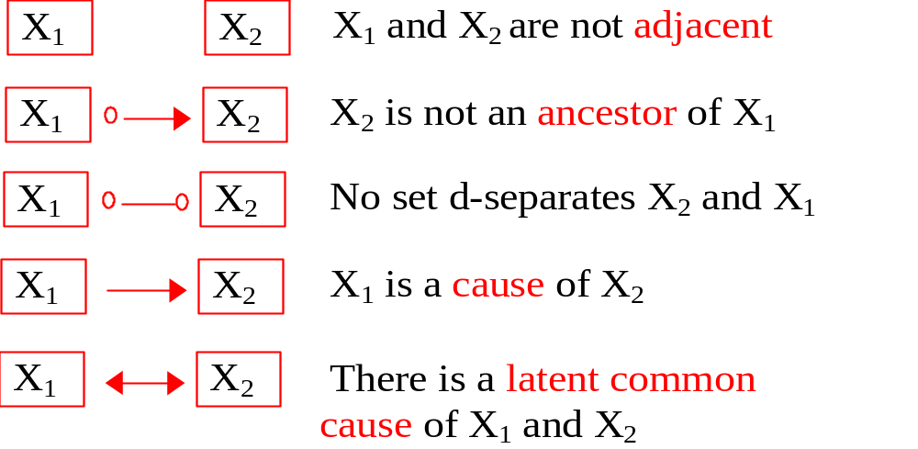
PAGs: Partial Ancestral Graphs
What PAG edges mean.
Notes:
1. represents set of conditional independence and distribution equivalent graphs
2. same adjacencies
3. undirected edges mean some contain edge one way, some contain other way
4. directed edge means they all go same way
5. Pearl and Verma -complete rules for generating from Meek, Andersson, Perlman, and Madigan, and Chickering
6. instance of chain graph
7. since data can’t distinguish, in absence of background knowledge is right output for search
8. what are they good for?

Slide 34
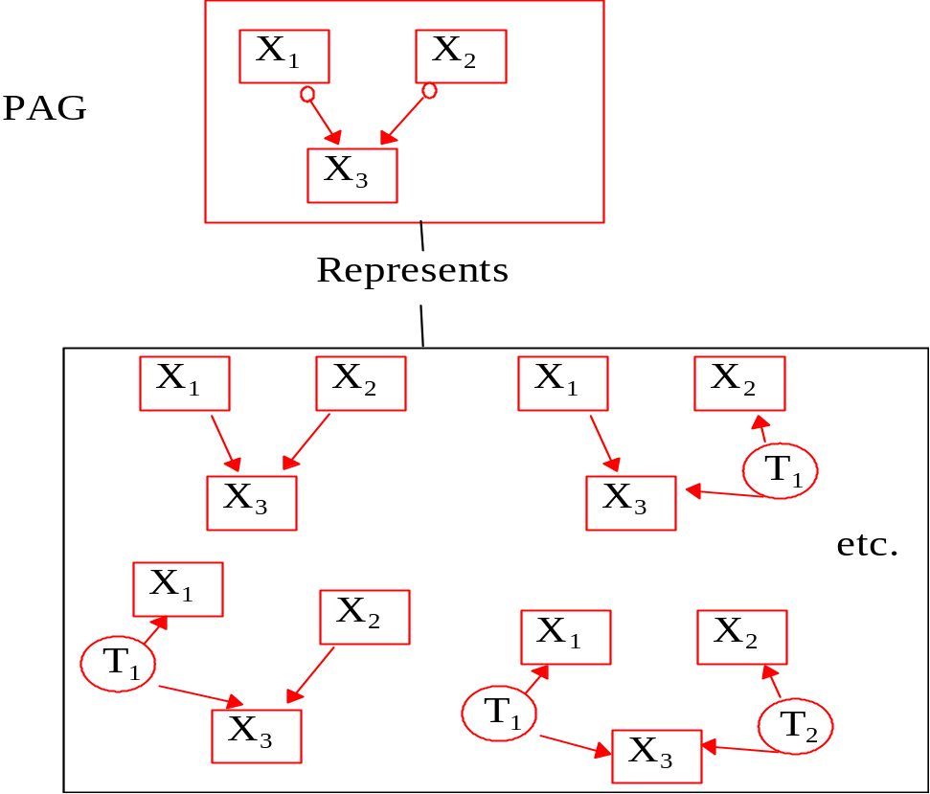
PAGs: Partial Ancestral Graph
Notes:
1. represents set of conditional independence and distribution equivalent graphs
2. same adjacencies
3. undirected edges mean some contain edge one way, some contain other way
4. directed edge means they all go same way
5. Pearl and Verma -complete rules for generating from Meek, Andersson, Perlman, and Madigan, and Chickering
6. instance of chain graph
7. since data can’t distinguish, in absence of background knowledge is right output for search
8. what are they good for?

Slide 35
Search Difficulties
The number of graphs is super-exponential in the number of observed variables (if there are no hidden variables) or infinite (if there are hidden variables)
Because some graphs are equivalent, can only predict those effects that are the same for every member of equivalence class
  Can resolve this problem by outputting equivalence classes

Slide 36
What Isn’t Possible
Given just data, and the Causal Markov and Causal Faithfulness Assumptions:
  Can’t get probability of an effect being within a given range without assuming a prior distribution over the graphs and parameters

Slide 37
What Is Possible
Given just data, and the Causal Markov and Causal Faithfulness Assumptions:
  There are procedures which are asymptotically correct in predicting effects (or saying “don’t know”)

Slide 38
Overview of Search Methods
Constraint Based Searches
  TETRAD
Scoring Searches
  Scores: BIC, AIC, etc.
  Search: Hill Climb, Genetic Alg., Simulated Annealing
  Very difficult to extend to latent variable models
Heckerman, Meek and Cooper (1999). “A Bayesian Approach to Causal Discovery” chp. 4 in Computation, Causation, and Discovery, ed. by Glymour and Cooper, MIT Press, pp. 141-166

Slide 39
Constraint-based Search
Construct graph that most closely implies conditional independence relations found in sample
Doesn’t allow for comparing how much better one model is than another
It is important not to test all of the possible conditional independence relations due to speed and accuracy considerations – FCI search selects subset of independence relations to test

Slide 40
Constraint-based Search
Can trade off informativeness versus speed, without affecting correctness
Can be applied to distributions where tests of conditional independence are known, but scores aren’t
Can be applied to hidden variable models (and selection bias models)
Is asymptotically correct

Slide 41
Search for Patterns
Adjacency:
X and Y are adjacent if they are dependent conditional on all subsets that don’t include X and Y
X and Y are not adjacent if they are independent conditional on any subset that doesn’t include X and Y

Slide 42
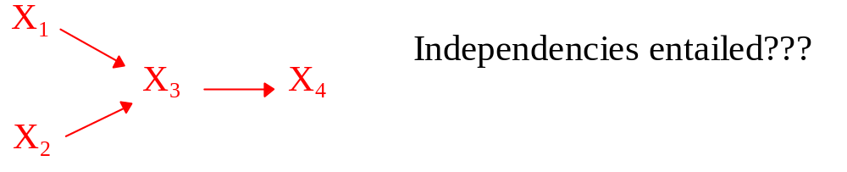
Search

Slide 43
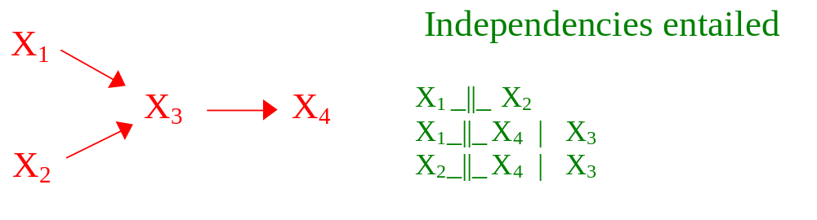
Search

Slide 44
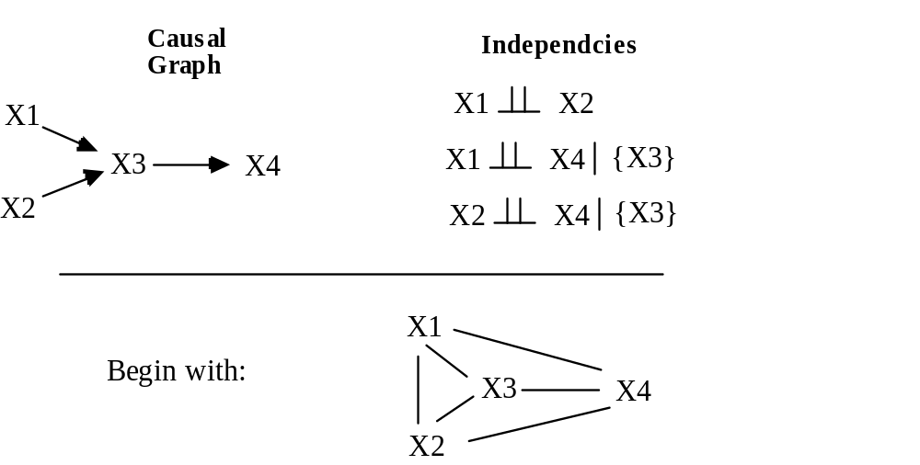
Search: Adjacency

Slide 45
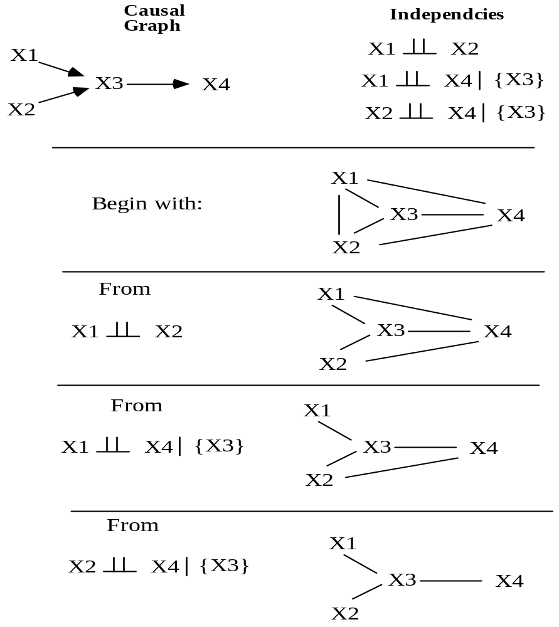

Slide 46
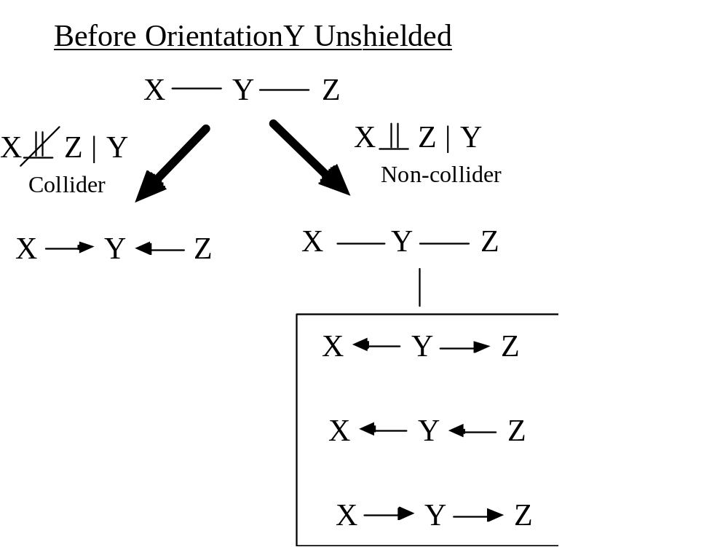
Search: Orientation in Patterns

Slide 47
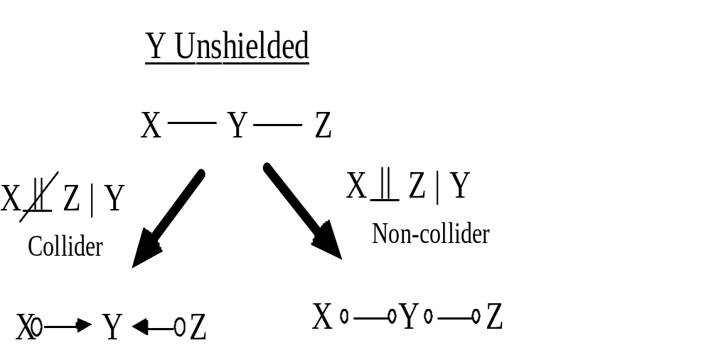
Search: Orientation in PAGs

Slide 48
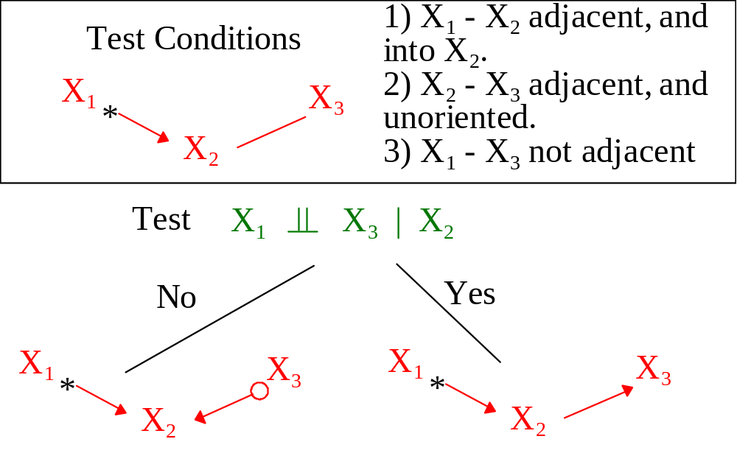
Orientation: Away from Collider

Slide 49
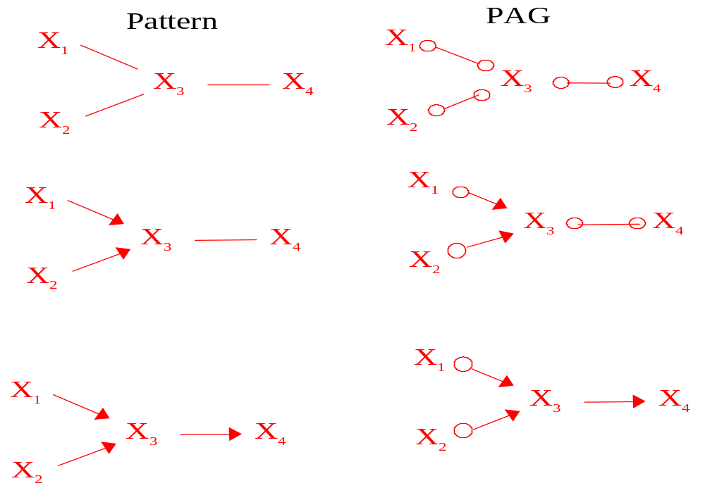
Search: Orientation
After Orientation Phase
X1 || X2
X1 || X4 | X3
X2 || X4 | X3

Slide 50
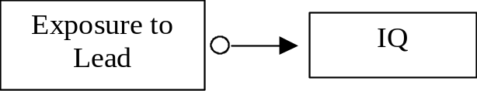
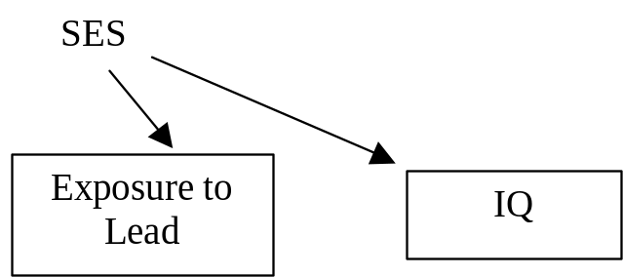
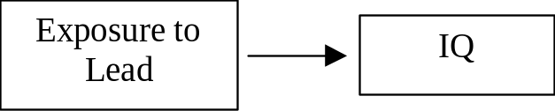
Knowing when we know enough to calculate the effect of Interventions
PAG
Observation: IQ _||_ Lead
Background Knowledge: Lead prior to IQ
P(IQ | Lead) ≠ P(IQ | Lead set=)
P(IQ | Lead) = P(IQ | Lead set=)

Slide 51
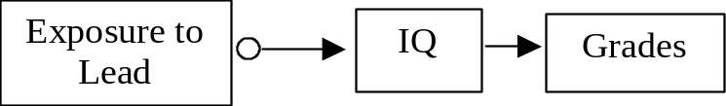
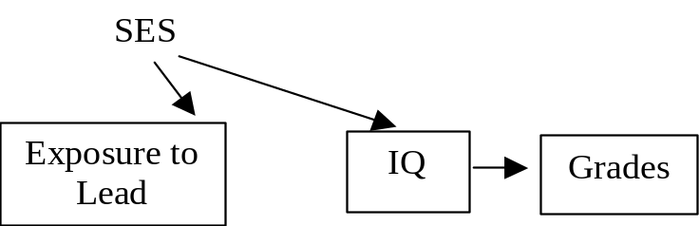
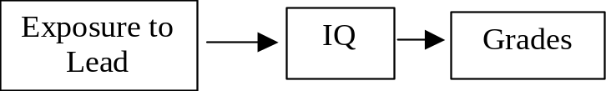
Knowing when we know enough to calculate the effect of Interventions
Observation: All pairs associated
Lead _||_ Grades | IQ
Background Lead prior to IQ prior Knowledge to Grades
PAG
P(IQ | Lead) ≠ P(IQ | Lead set=)
P(Grades | IQ) = P(Grades | IQ set=)
P(IQ | Lead) = P(IQ | Lead set=)
P(Grades | IQ) = P(Grades | IQ set=)

Slide 52
Knowing when we know enough to calculate the effect of Interventions
Causal graph known
Features of causal graph known
  Prediction algorithm (SGS - 1993)
    Data tell us when we know enough – i.e., we know when we don’t know

Slide 53
4. Problems with Using Regession for Causal Inference

Slide 54
Regression to estimate Causal Influence
Let V = {X,Y,T}, where
-measured vars: X = {X₁, X₂, …, X_{n}}
-latent common causes of pairs in X U Y: T = {T₁, …, T_{k}}
Let the true causal model over V be a Structural Equation Model in which each V ∈ V is a linear combination of its direct causes and independent, Gaussian noise.

Slide 55
Regression to estimate Causal Influence
Consider the regression equation:
Y = b₀ + b₁X₁ + b₂X₂ + ..…b_{n}X_{n}
Let the OLS regression estimate b_{i} be the estimated causal influence of X_{i} on Y.
That is, holding X/Xi experimentally constant, b_{i} is an estimate of the change in E(Y) that results from an intervention that changes Xi by 1 unit.
Let the real Causal Influence X_{i} → Y = β_{i}
When is the OLS estimate b_{i} an unbiased estimate of the the real Causal Influence X_{i} → Y = β_{i} ?

Slide 56
Regression vs. PAGs to estimate Qualitative Causal Influence
b_{i} = 0 ⇔ Xi _||_ Y | X/Xi
Xi - Y not adjacent
in PAG over X U Y ⇔ ∃S ⊆ X/Xi, Xi _||_ Y | S
So for any SEM over V in which
  Xi _||_ Y | X/Xi and
  ∃S ⊂ X/Xi, Xi _||_ Y | S
PAG is superior to regression wrt errors of commission

Slide 57
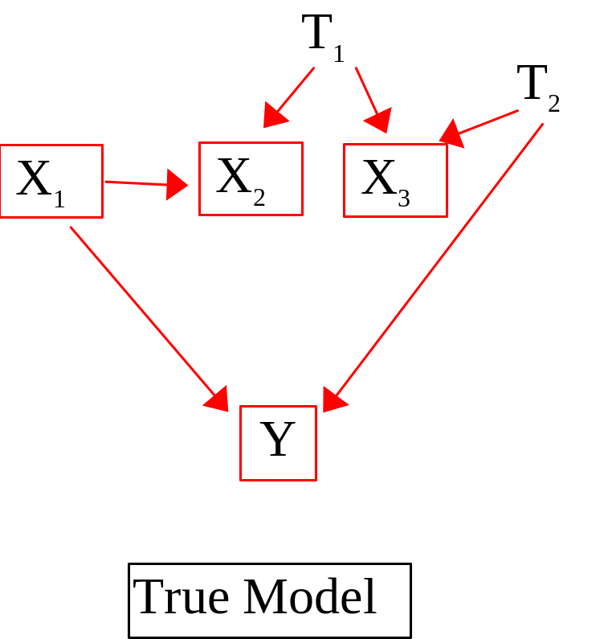
Regression Example
b₁
≠ 0 
b₂
≠ 0 X
b₃
≠ 0 X
X₁
X₂
X₃
PAG
Y

Slide 58
Regression Bias
If
X_{i} is d-separated from Y conditional on X/X_{i} in the true graph after removing X_{i} → Y, and
X contains no descendant of Y, then:
b_{i} is an unbiased estimate of β_{i}

Slide 59
Regression Bias Theorem
If T = ∅, and X prior to Y, then
b_{i} is an unbiased estimate of β_{i}

Slide 60
Tetrad 4 Demo
www.phil.cmu.edu/projects/tetrad

Slide 61
Applications
Rock Classification
Spartina Grass
College Plans
Political Exclusion
Satellite Calibration
Naval Readiness
Genetic Regulatory Networks
Pneumonia
Photosynthesis
Lead - IQ
College Retention
Corn Exports

Slide 62
MS or Phd Projects
Extending the Class of Models Covered
New Search Strategies
Time Series Models (Genetic Regulatory Networks)
Controlled Randomized Trials vs. Observations Studies

Slide 63
Projects: Extending the Class of Models Covered
1) Feedback systems
2) Feedback systems with latents
3) Conservation, or equilibrium systems
4) Parameterizing discrete latent variable models

Slide 64
Projects: Search Strategies
  1) Genetic Algorithms, Simulated Annealing
  2) Automatic Discretization
  3) Scoring Searches among Latent Variable Models
  4) Latent Clustering & Scale Construction

Slide 65
References
Causation, Prediction, and Search, 2nd Edition, (2001), by P. Spirtes, C. Glymour, and R. Scheines ( MIT Press)
Causality: Models, Reasoning, and Inference, (2000), Judea Pearl, Cambridge Univ. Press
Computation, Causation, & Discovery (1999), edited by C. Glymour and G. Cooper, MIT Press
Causality in Crisis?, (1997) V. McKim and S. Turner (eds.), Univ. of Notre Dame Press.
TETRAD IV: www.phil.cmu.edu/tetrad
Web Course on Causal and Statistical Reasoning : www.phil.cmu.edu/projects/csr/
Notes:
1

